Slide 1
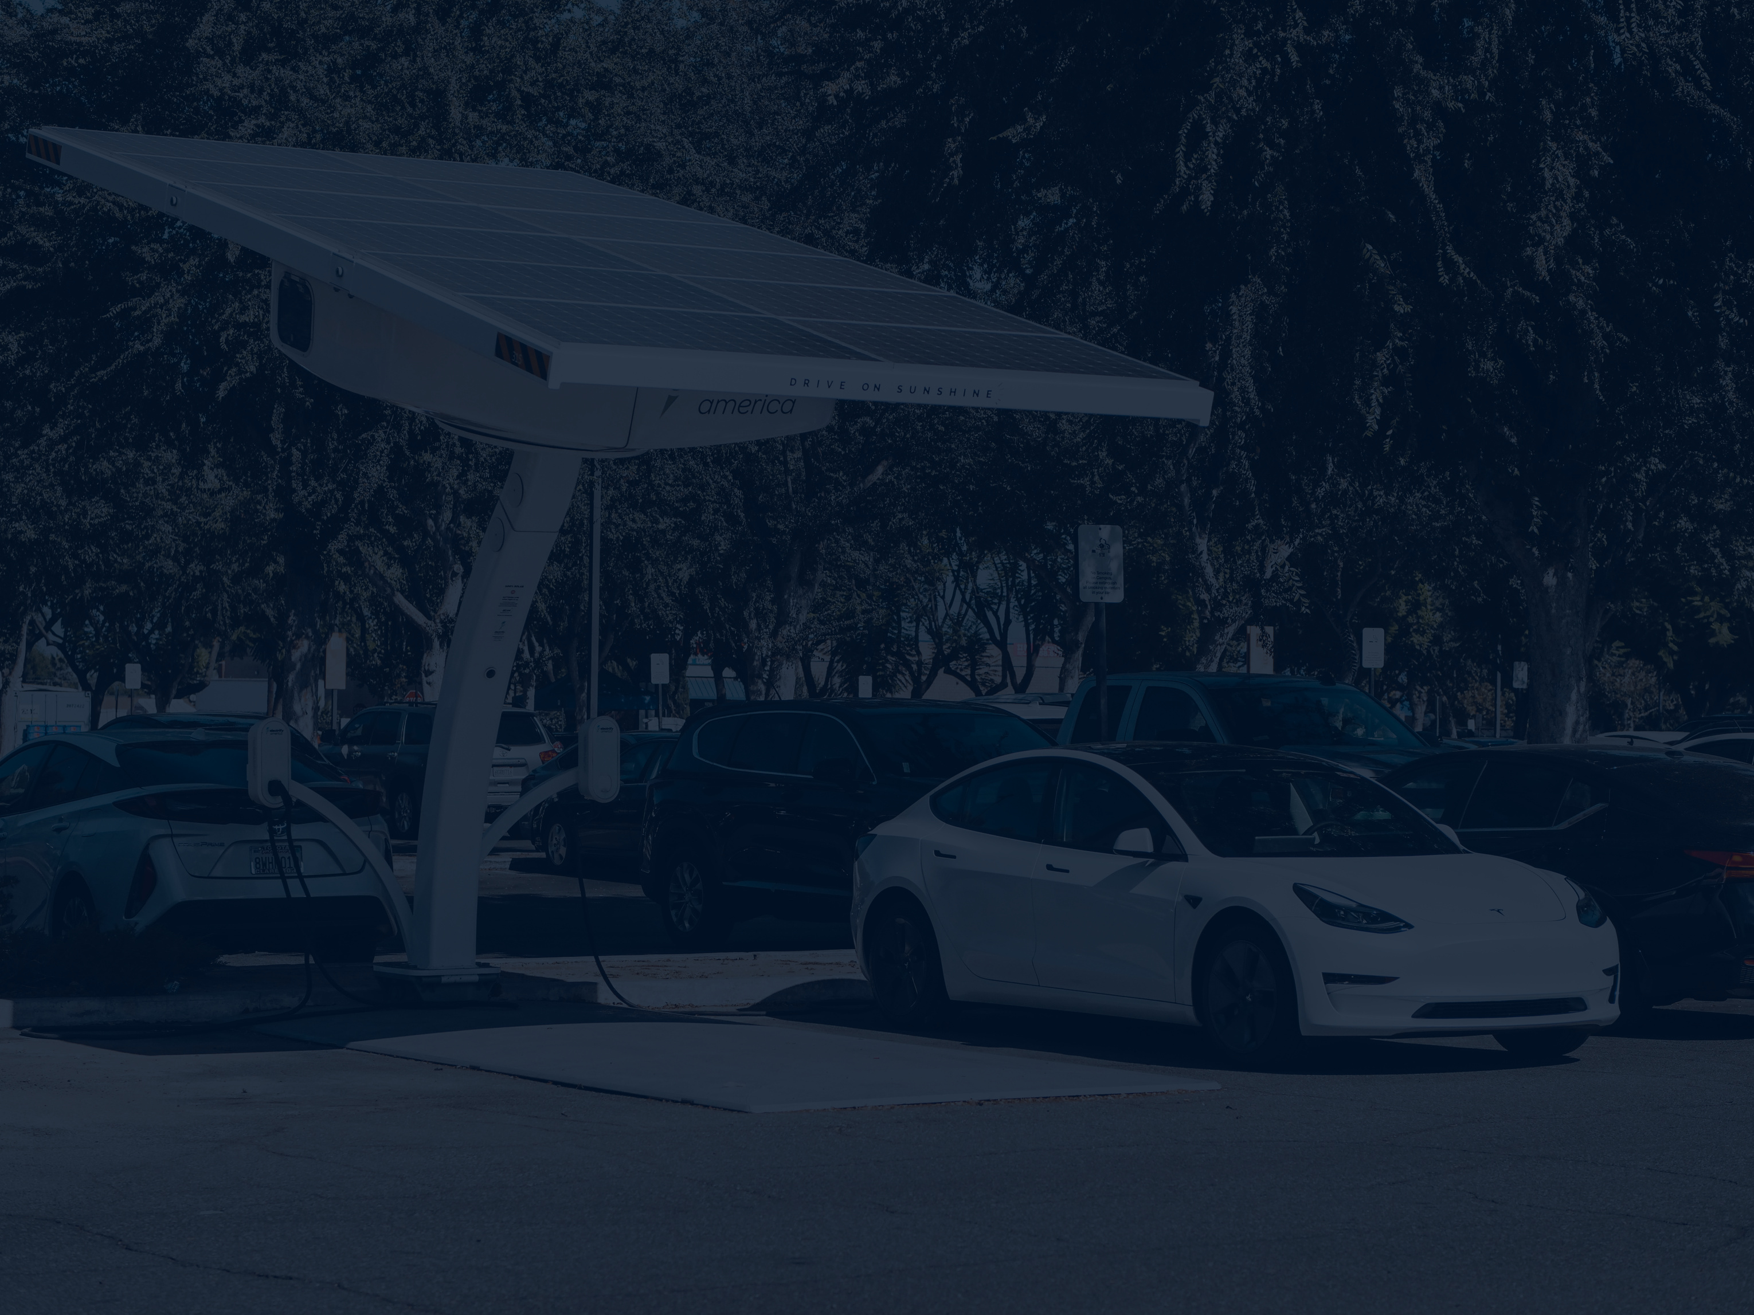



Vấn đề của chương 2
Bài thuyết trình
HỌ và tên: Nguyễn Thành Luân
Lớp:CNKO-K13A

Slide 2
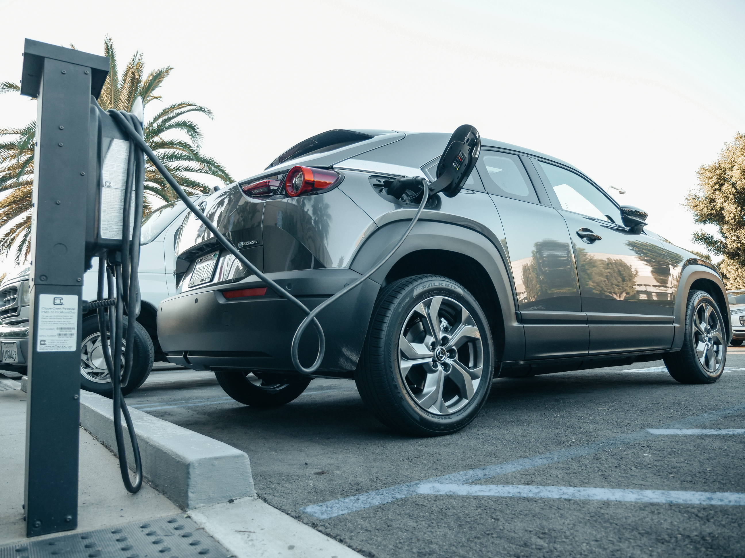
ICông Nghệ Pin Trong Xe Ô Tô Điện
1. Chức năng chính của pin
Cung cấp năng lượng cho động cơ điện
-Lưu trữ từ quá trình sạc và tái tạo năng lượng khi phanh

Slide 3

2. Các loại pin phổ biến
01
02
Lithium-ion (Li-ion)
Phổ biến nhất hiện nay
Mật độ năng lượng cao, tuổi thọ tốt
PHEV (Plug-in Hybrid)
Battery & small petrol engine
40–80 km
Mixed city/highway travel
03
04
HEV (Hybrid)
Petrol engine
No plug-in; boosts efficiency
Taxis, fleet vehicles
FCEV (Fuel-Cell EV)
Hydrogen + electric motor
300–600 km
Long-distance, heavy duty

Slide 4


CHARGING INFRASTRUCTURE
As electric vehicles become more popular, accessible and reliable charging infrastructure is essential. The EV ecosystem depends on various levels of charging, growing public access, and smart technology integration to support everyday use.

Slide 5
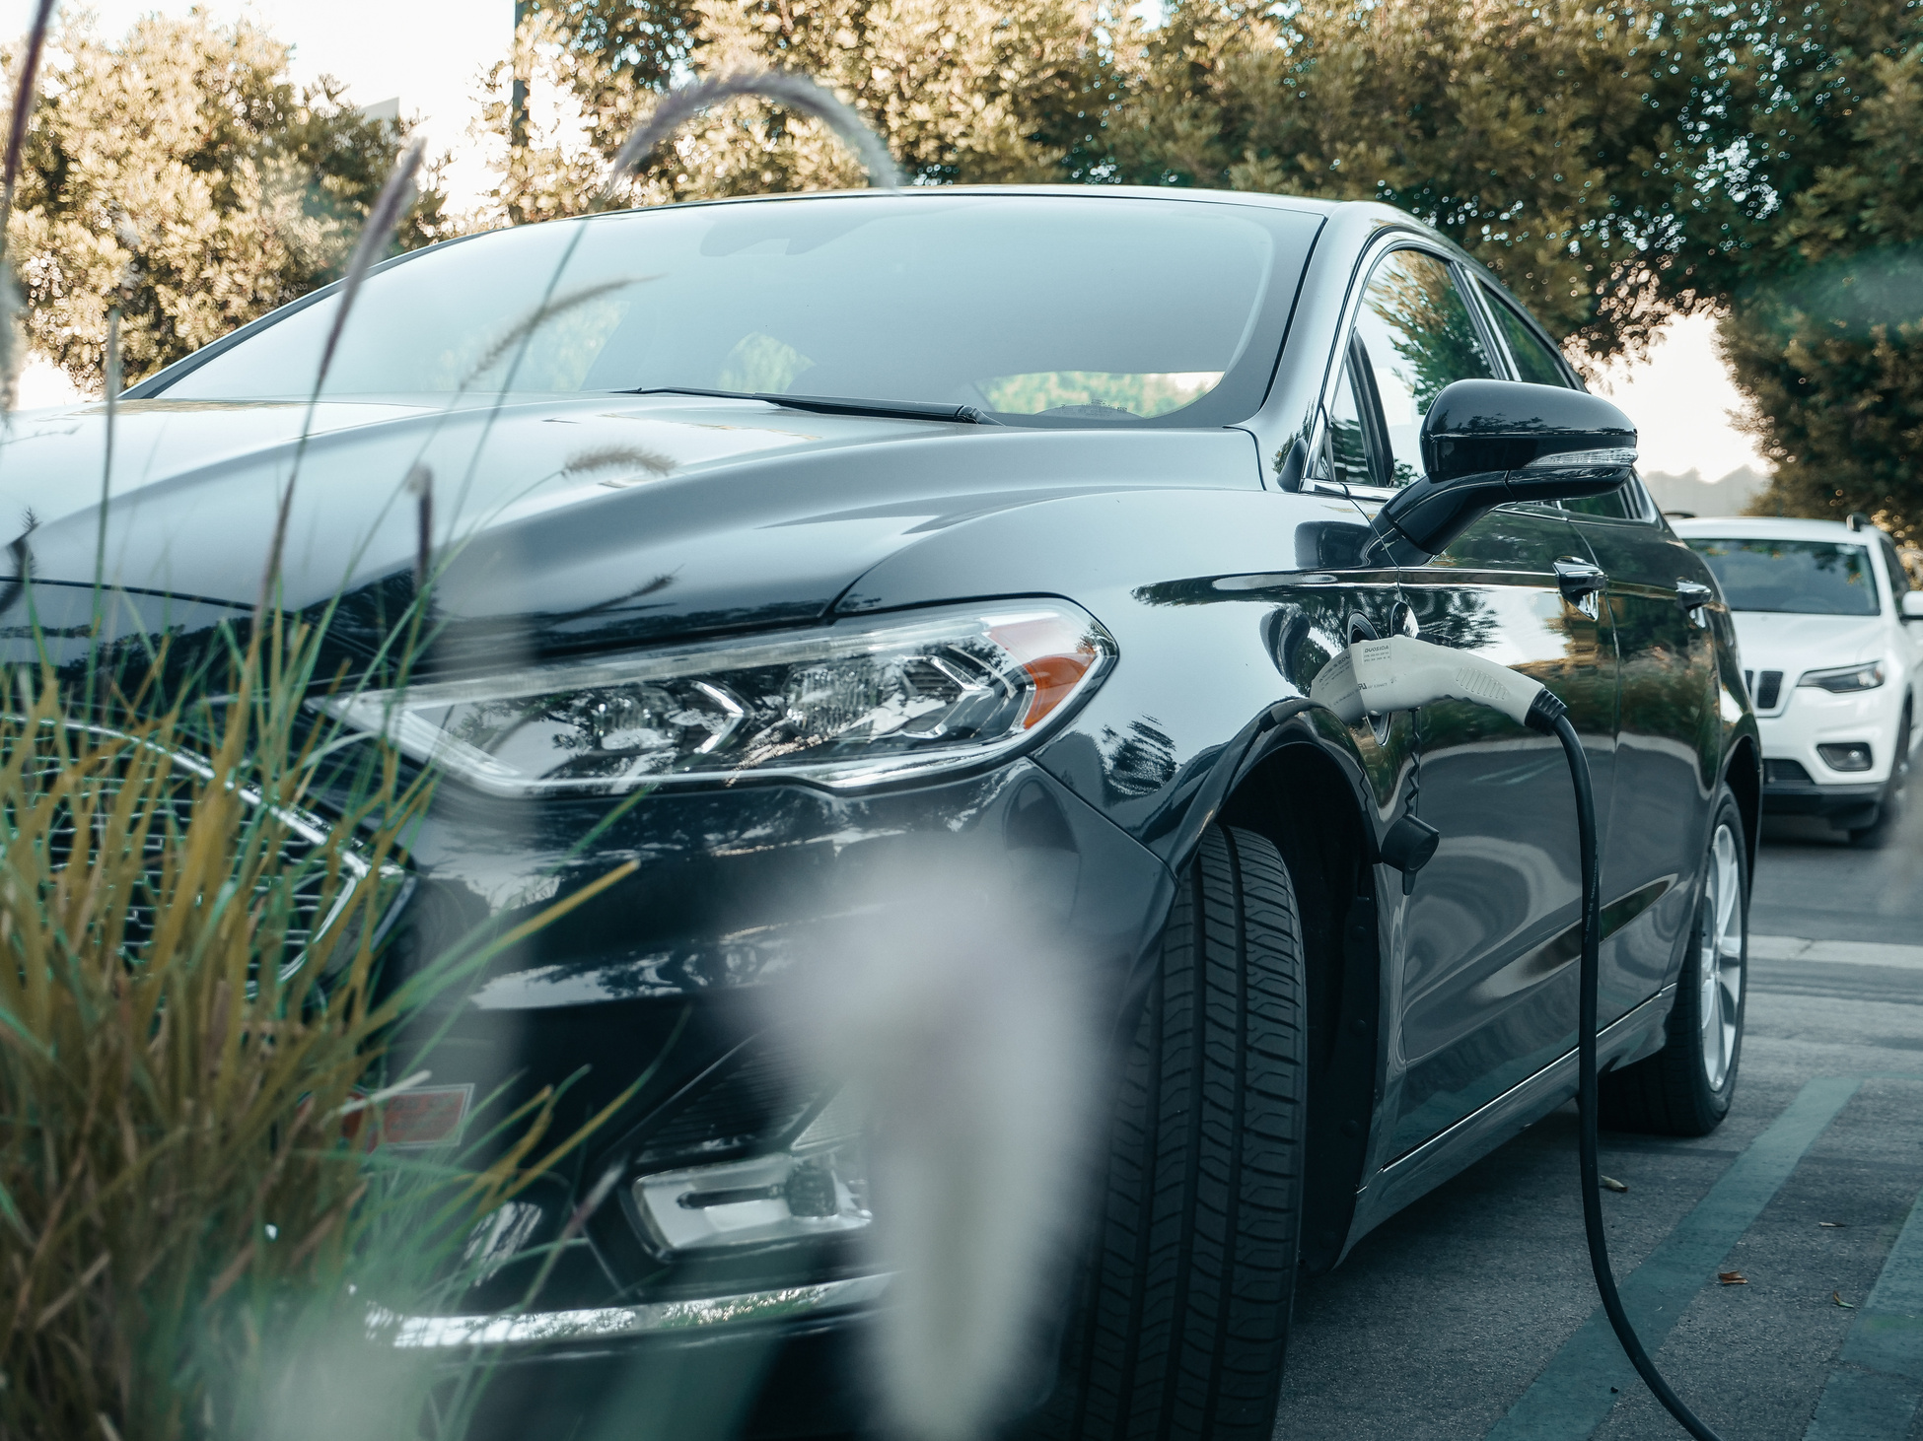
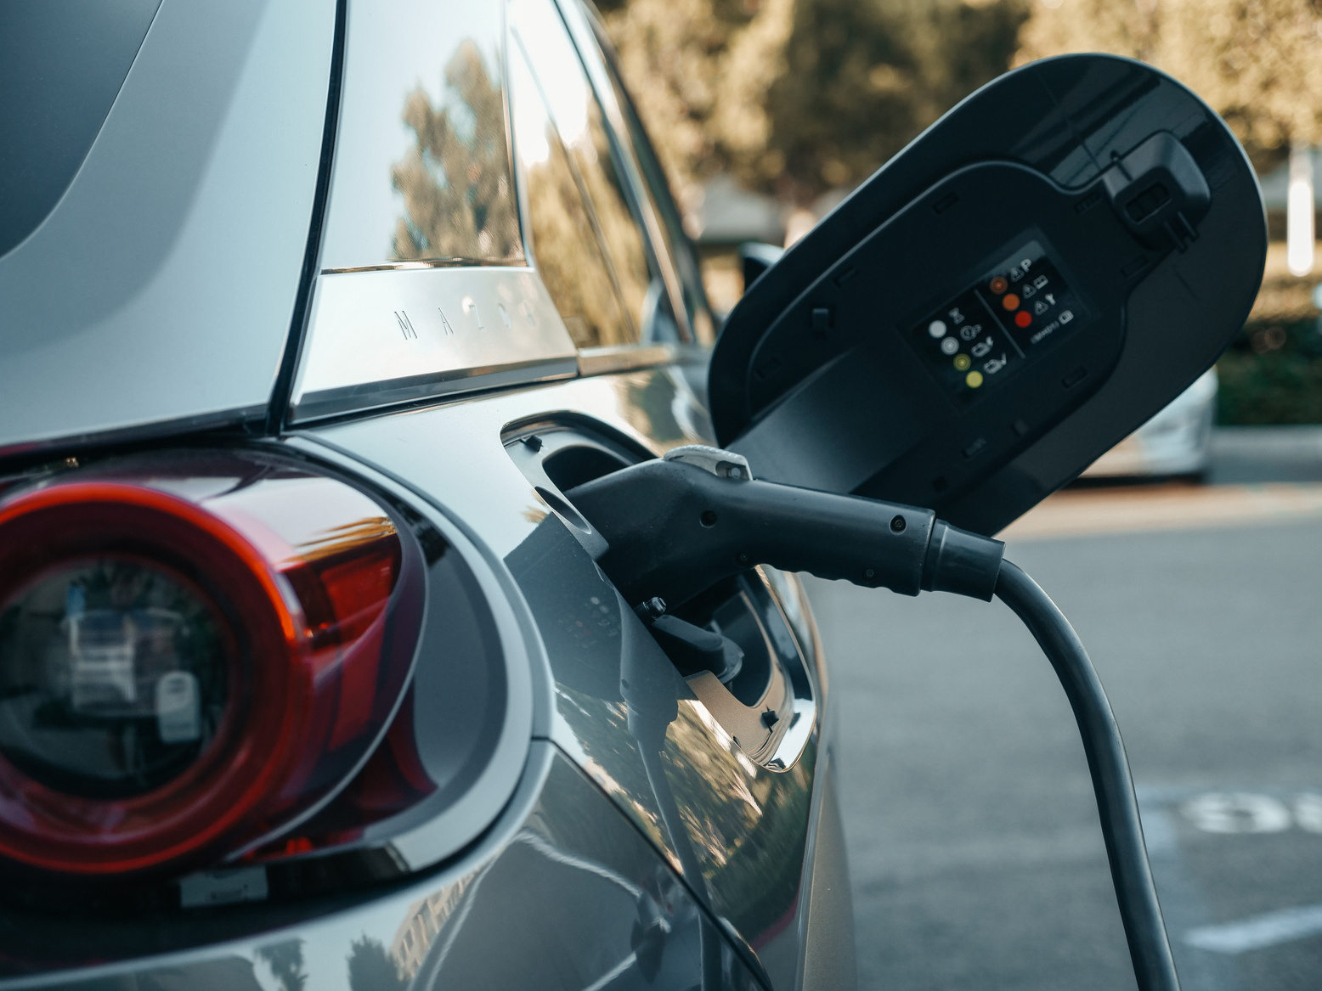
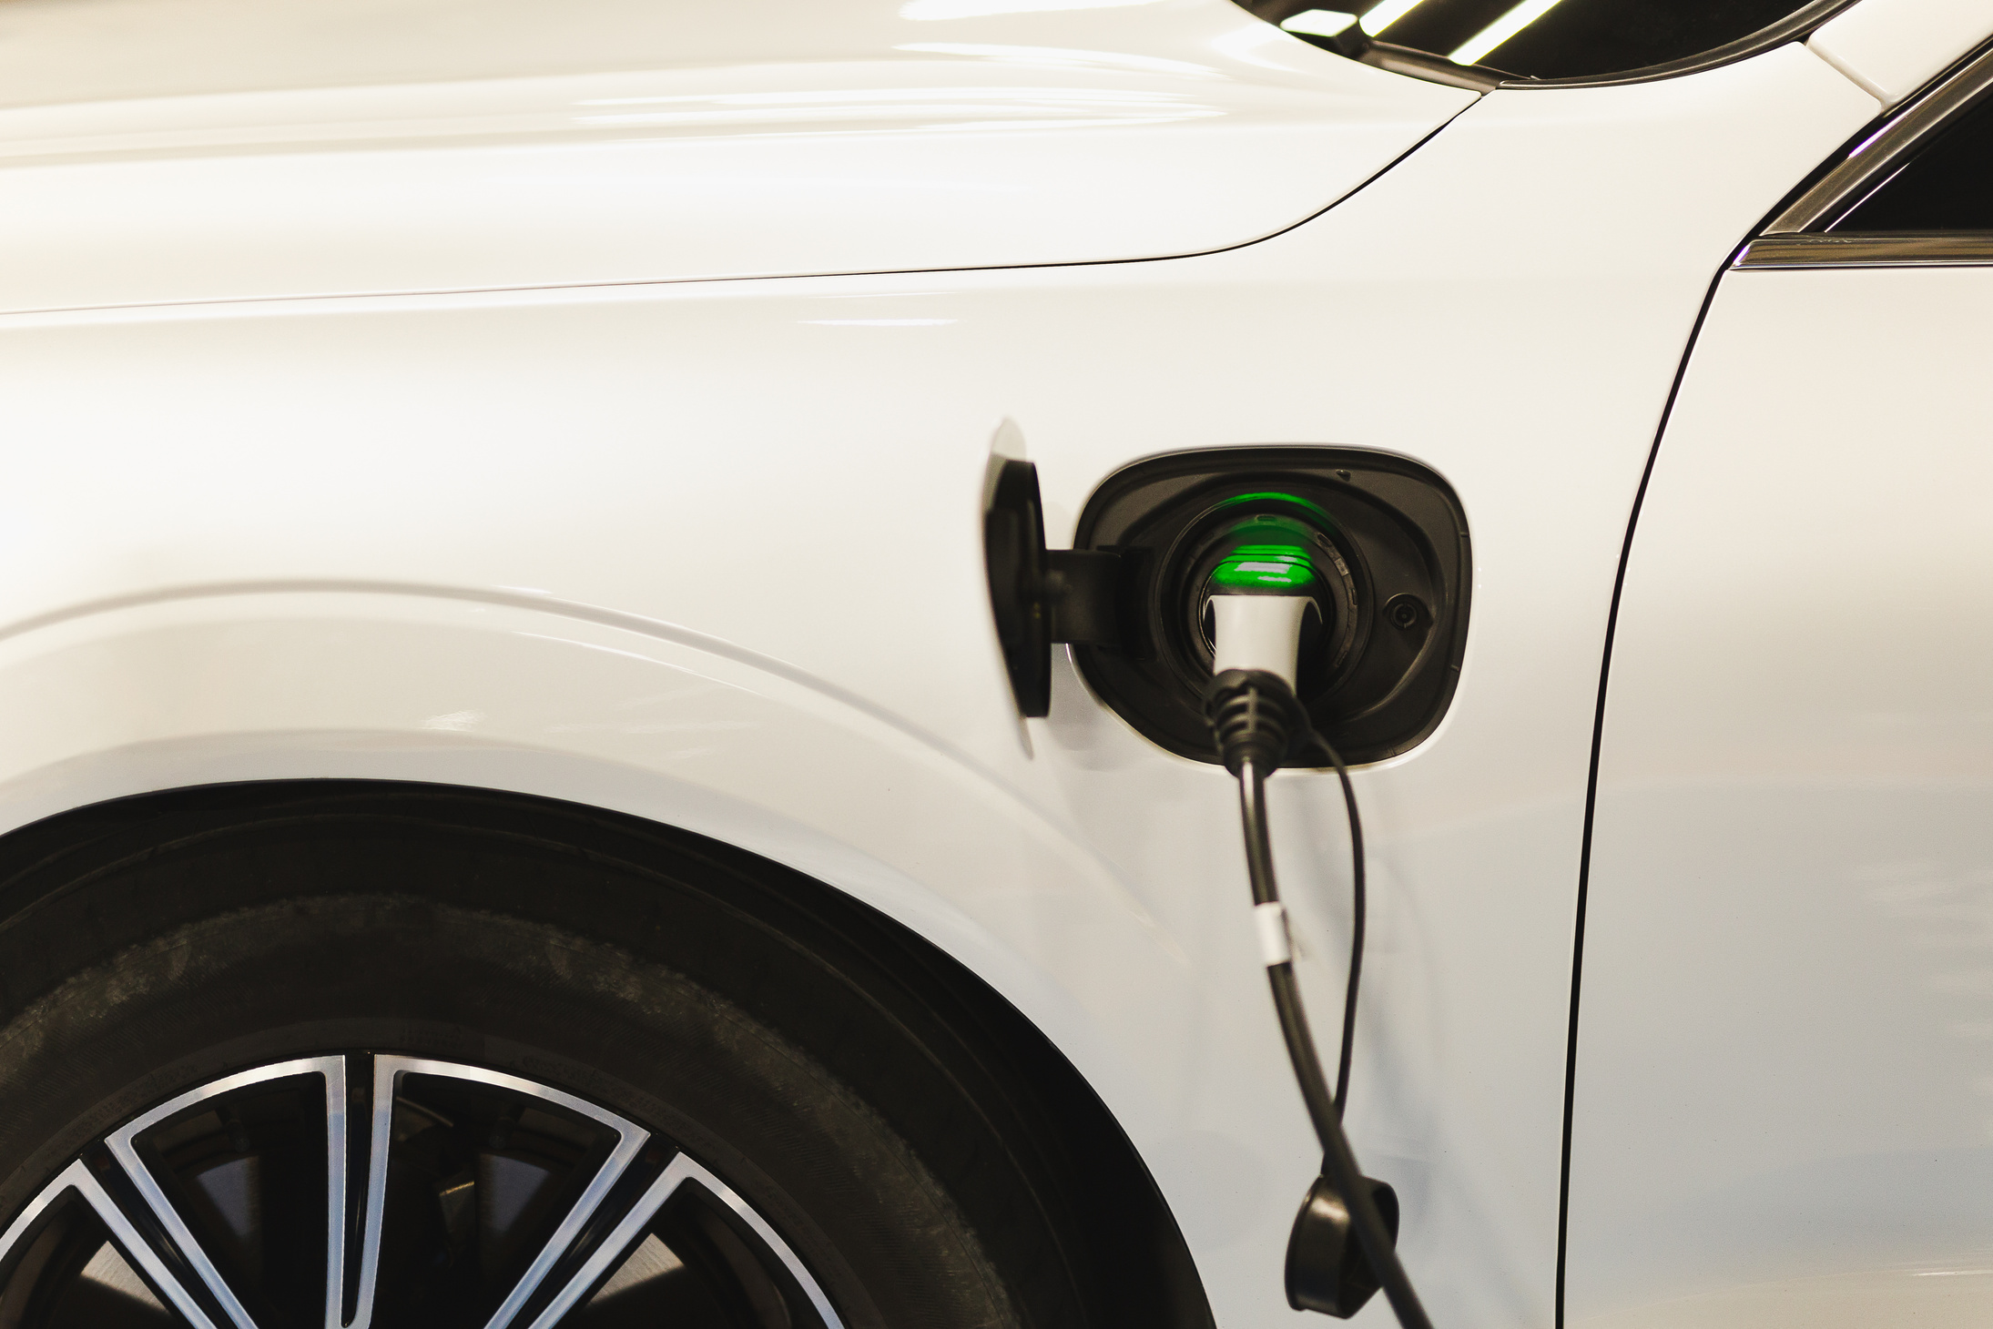
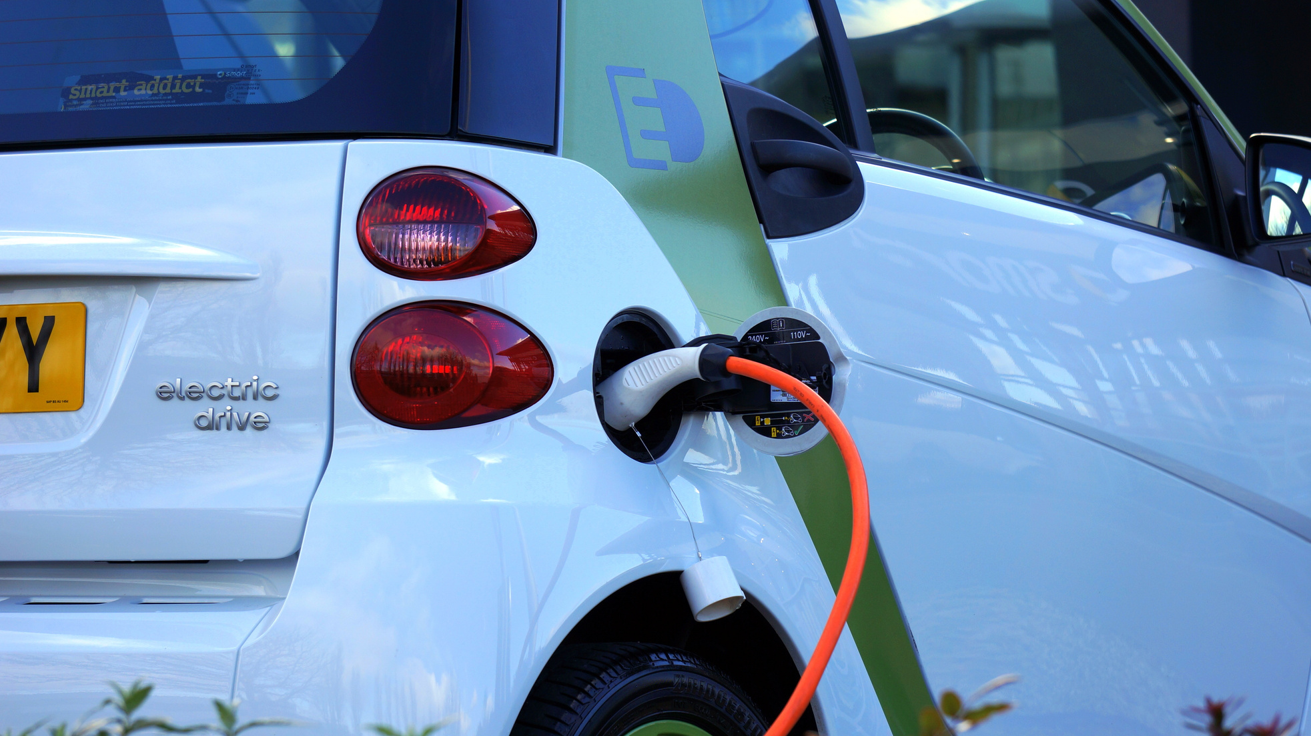
EV TECHNOLOGY ESSENTIALS
BATTERY PACK
INVERTER & MOTOR
THERMAL MANAGEMENT
REGENERATIVE BRAKING
Lithium-ion chemistry dominates; energy density improving ~7 % annually
Convert DC battery power to AC and drive high-torque motors
Liquid cooling keeps batteries within 15–35 °C for safety & longevity
Recovers up to 30 % of braking energy to recharge the pack

Slide 6
MARKET TRENDS
50%
14M
EV sales have surged worldwide, growing by over 50% annually in recent years.
18%
14 million EVs sold globally in 2023
Represented 18% of all new car sales in 2023

Slide 7
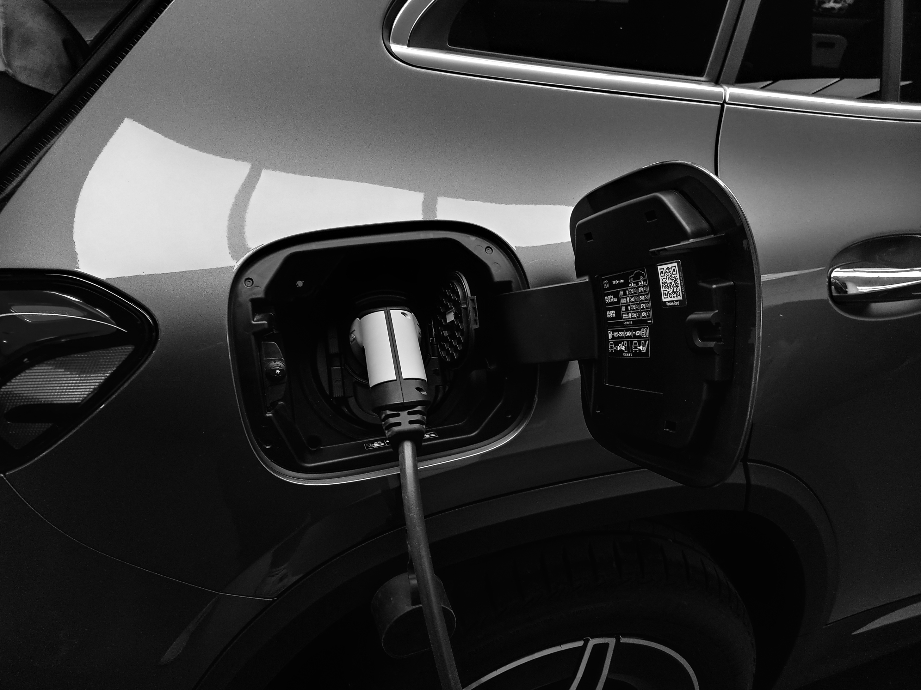
ECONOMIC & SOCIAL BENEFITS
Beyond being eco-friendly, electric vehicles offer significant economic advantages and contribute to broader social development. Here's how EVs impact wallets, workforces, and national economies:
LOWER RUNNING COSTS
Charging an EV is considerably cheaper than refueling with gasoline or diesel. On average, the cost per kilometer is about 30–60% lower
MAINTENANCE SAVINGS
EVs have fewer moving parts compared to internal combustion engine vehicles. They don’t require oil changes, fuel filters, or exhaust system repairs.

Slide 8



ENVIRONMENTAL IMPACT
Electric vehicles (EVs), particularly battery electric vehicles (BEVs), are changing transportation's environmental impact by reducing emissions and promoting a cleaner, quieter, and more sustainable future.
TAILPIPE EMISSIONS
LIFECYCLE CO₂ EMISSIONS
BATTERY RECYCLING & SUSTAINABILITY

Slide 9
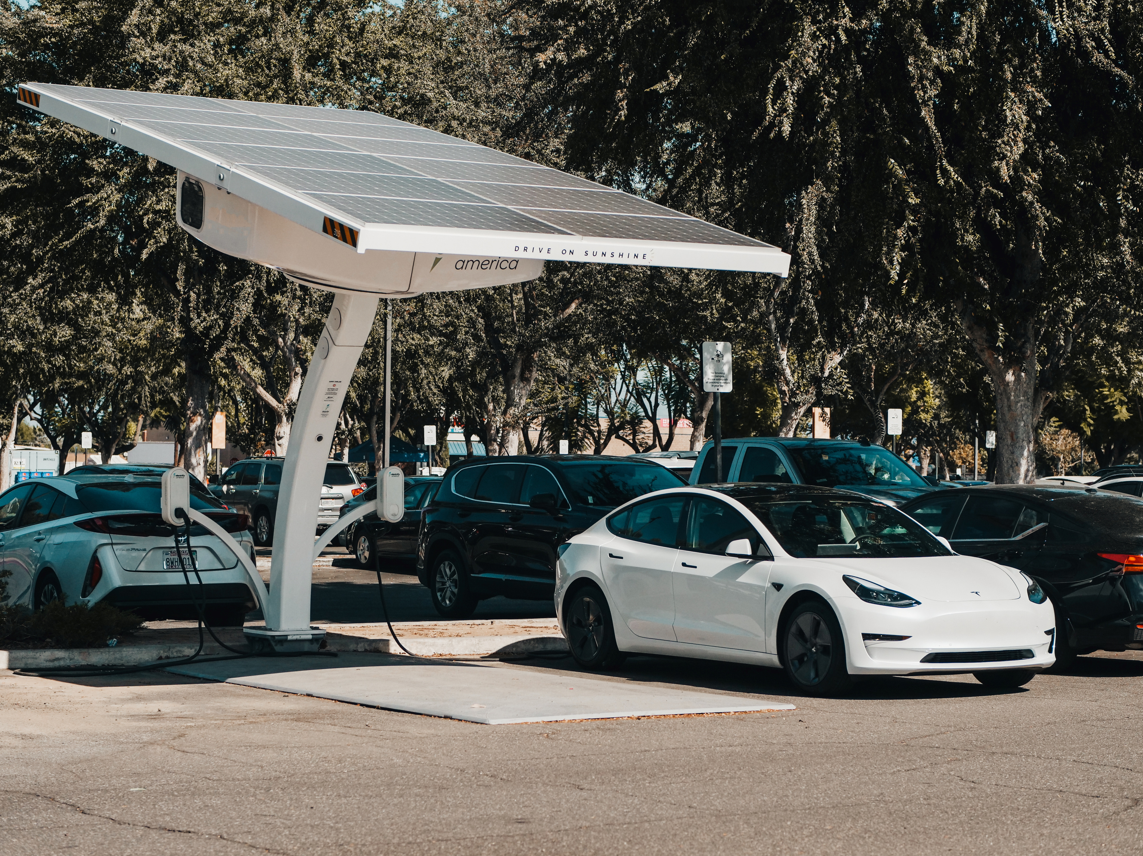
CHALLENGES AHEAD
Despite the growing momentum for electric vehicles, several key challenges remain that need to be addressed to ensure sustainable and widespread adoption.
UP-FRONT COST
RANGE ANXIETY
Electric vehicles are still generally more expensive than internal combustion engine vehicles, primarily due to battery costs.
This "range anxiety" persists even though most daily trips are less than 50 kilometers, well within the capabilities of most modern EVs.

Slide 10
THANK YOU!
WE APPRECIATE YOUR TIME AND INTEREST.

